Slide 1


Workplace Mental Health
& Employee Mental Wellbeing
PRESENTED BY
Kate Kennedy-Lynch, Director, External Relations, NAMI
National Retail Federation• 5.11.23

Slide 2
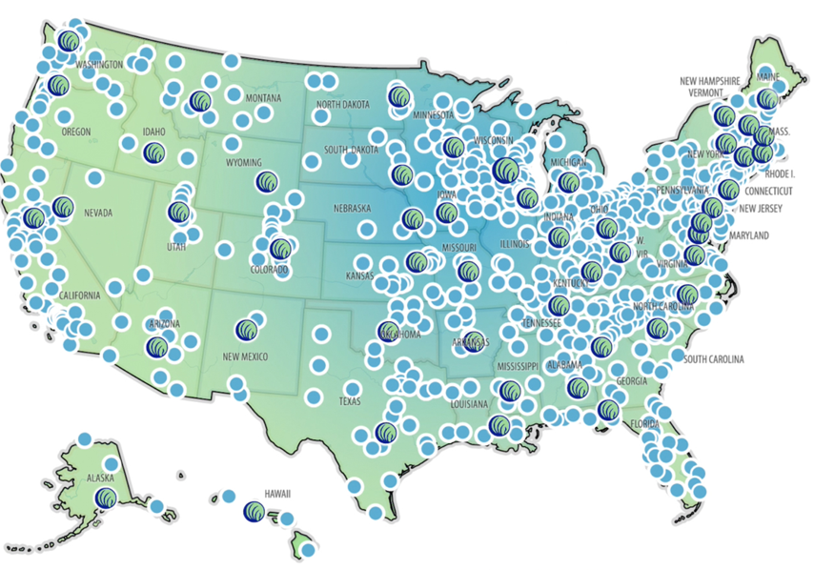
Who We Are
The National Alliance on Mental Illness (NAMI) is the nation’s largest grassroots mental health organization dedicated to building better lives for the millions of people affected by mental illness.
What started as two mothers gathered around a
kitchen table in 1979 has blossomed into the
nation’s leading voice on mental health. Today,
NAMI is an alliance of more than 600 local Affiliates
and 49 State Organizations who work in your
community to raise awareness and provide support and
education that was not previously available to those in need.
Notes:
Largest grassroots mental health org in the US; over 650 state and local affiliates; the idea is we’re everywhere the need is
NAMI Virginia in Richmond, NAMI Northern Virgnia in Arlington, a NAMI Blue Ridge Charlottesville, etc. NAMI Keystone Pennsylvania where my parents are outside of Pittsburgh – NAMI Alaska, NAMI Hawaii, we’re everywhere.
We were founded in 1979 by two mothers who 1) found each other, which became a core tenet of our work –
and 2) - were seeking better care and better outcomes for their children who lived with schizophrenia.
Today, we provide ADVOCACY, EDUCATION, SUPPORT, and AWARENESS across the country,
primarily through FREE, peer-led support groups at our affiliates.

Slide 3

Global Pandemic
Racial Inequities & Political Tensions
Economic Uncertainty
Sustained Stress
Collective Grief & Loss
Isolation & Loneliness
Extreme Disruption
Notes:
So how did we get here
Onset of covid – abruptly changed things in March 2020
We like certainty, predictability – not unlike my toddler – the disruption was really a pause to examine our priorities and existence. Really good versus really changing our perspective on work.
Trifecta: global pandemic, political and racial tension, economic uncertainty

Slide 4
Mental health impacts a person’s cognition, behavior, emotional, social and relational well-being and functioning, physical health, and well-being as it relates to work.
It also impacts a person’s productivity and performance. Presenteeism, or lost productivity, accounts for the largest financial costs, with absenteeism and staff turnover affecting workers, employers, and a society’s economy.
WHO Guidelines on Mental Health at Work
Notes:
So how does this apply to the workplace? What are we all experiencing in the context of work?
Well – our lives are intertwined with work. We spend so much time...

Slide 5
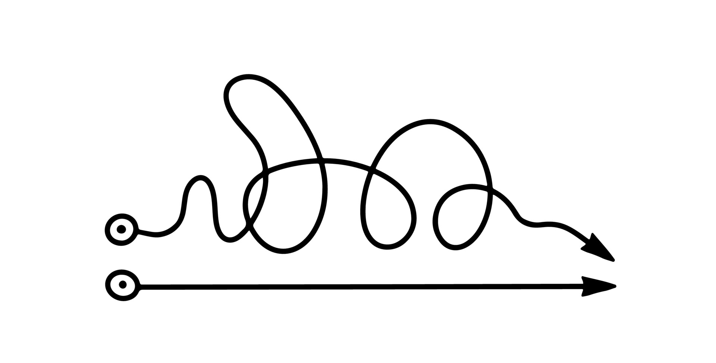
What might these two lines represent?
Illustrator: Tatiana Elantseva online @ vecteezy.com

Slide 6

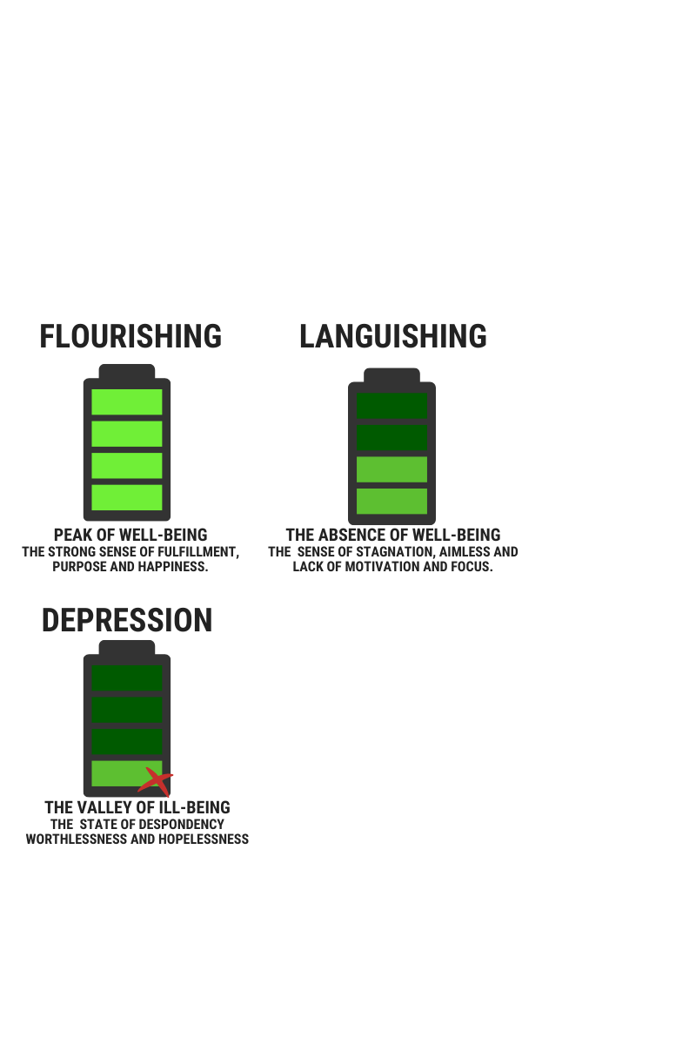
Mental Health Exists Along a Continuum
NYT, April 19, 2021, Adam Grant on Languishing.

Slide 7
The Breakdown
Anxiety: 19.1%
Depression: 8.4%
Bipolar Disorder: 2.8%
Schizophrenia: <1.0%
PTSD: 3.6%
Substance Use Disorder: 11.8%
1 in 5 adults live with a ​mental health condition​
​
1 in 20 lives with a Serious Mental Illness (SMI)

Slide 8
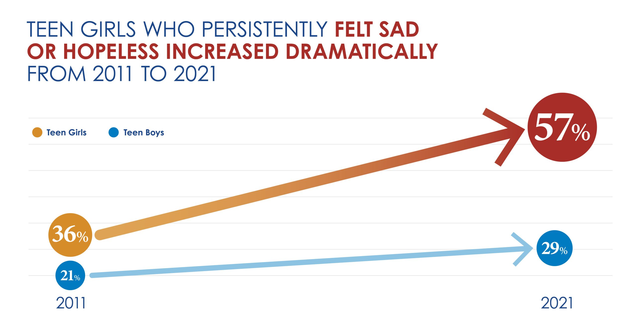
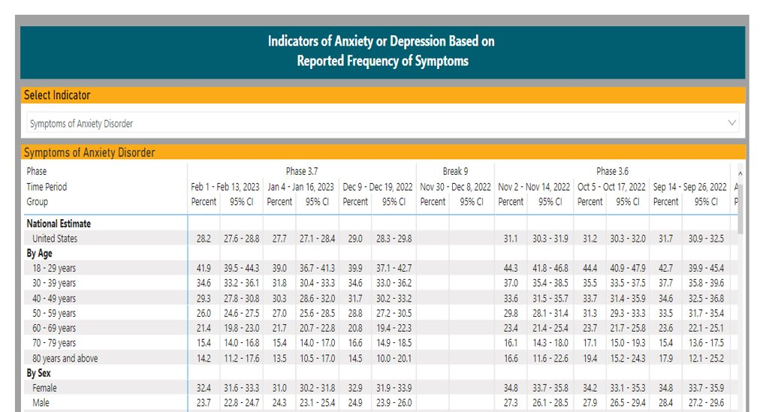

Fast Facts & Stats
CDC Data

Slide 9
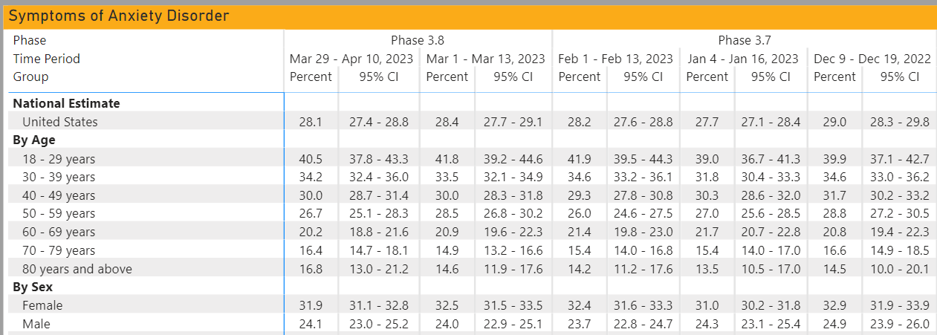
Indicators of Anxiety or Depression Based on Reported Frequency of Symptoms
Source: Weekly pulse survey data collected by the CDC since March 2020.
Go to: https://www.cdc.gov/nchs/covid19/pulse/mental-health.htm
Notes:
We have the data to back this up -
This is data from a weekly survey collected by the CDC since March 2020 –
Current numbers show that 28.2% of respondents in the US are reporting symptoms of Anxiety Disorder
And let’s look at this block – 18-29 years old – averaging 40% for months now.
We know we’re seeing particularly high rates of mental health conditions and crises in youth and young people; when we think about the workforce, we're looking at Gen Z here. Gen Z is really driving the conversation around authentic commitment to mental health too

Slide 10
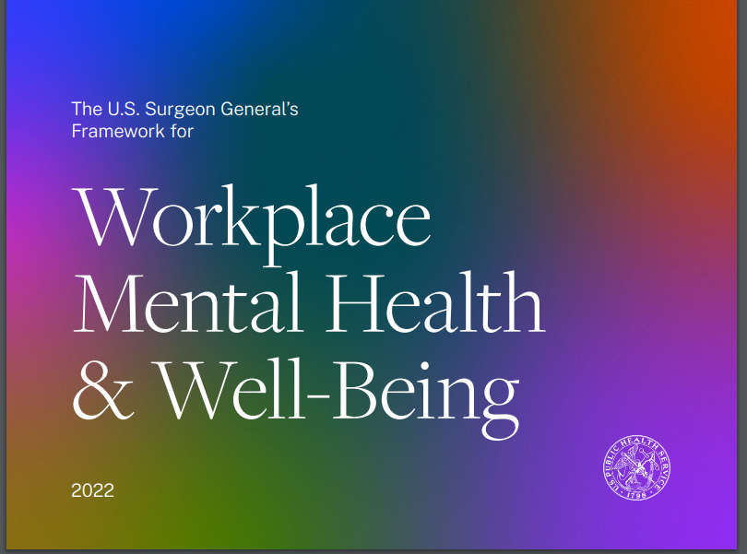


RECENT reports on WMH …
SG Report: https://www.hhs.gov/sites/default/files/workplace-mental-health-well-being.pdf
WHO Report: https://www.who.int/publications/i/item/9789240053052
USC Annenberg Report: https://issuu.com/uscannenberg/docs/relevance-report-2022
Notes:
There are also some additional reports focused on why now –
US Surgeon General Dr. Murthy is SUPER passionate about mental health and has touted the benefits of meditation – it’s always wonderful to have mental health at the forefront of these conversations at the highest government levels.

Slide 11
More Stats & Facts
MH affects people during prime working years and family members too.
1/2 of adults with a SUD also have a co-occurring MH condition.
People may delay MH care for 10+ years, which can worsen conditions.
Less than 1/2 of adults with a diagnosable MH condition receive treatment.
Notes:
Why are we having the conversation around mental health? To NORMALIZE IT – because the numbers show that everyone experiences some condition or loves someone who does.
We can absolutely talk statistics – we have a lot of them, research is part of what we enable at NAMI –
Two additional points to add to this:
First, people don’t often get care – or don’t receive a correct diagnosis for 10+ years.
If you equate mental health to physical health, which you should, as mental health is physical health – you would not wait 10 years to seek care for a broken leg, or diabetes, or heart disease. Outcomes can be much worse. And it’s the same with mental illness.
Even more wild, less than ½ of adults w/ a diagnosable mhc receive treatment. It’s hard to think about that as a statistic. There’s a variety of reasons people don’t seek care, and one of the primary reasons is stigma.
(youth stats are from JAMA study in 2019 so things have changed so quickly in the last three years that we’re still gathering new data, but we know about the prevalence.)

Slide 12
What is Burnout?
Negative About Oneself
Negative
& Cynical
Exhaustion
Stress response causing people to feel physically, emotionally, and cognitively exhausted.
Feeling negative and cynical toward work, people at work, and others.
Thinking what is wrong with me and why can’t I handle this.
World Health Organization, May 2019

Slide 13


How are organizations addressing mental health?
MH Education, Resources & More
Creating a Caring Culture
Improving Access to Care & Support
MH impacts retention, recruitment, performance, productivity, & more.
Burnout, excessive stress & higher rates of mental health conditions.
Value in creating a caring culture.
How it impacts the bottom line.
Notes:
Retention and recruitment issues
Feelign valued, feeling like you’re contributing to the organization really makes people feel connected to a company
What about other types of workplaces

Slide 14
Six Factors for Tackling Burnout
Workload
Autonomy & Control
Reward & Recognition
Community & Sense of Belonging
Fairness in Opportunities
Values & Purpose in work
Christina Maslach, Ph.D.
Notes:
SHRM:
Themes: Culture, Mental Health, and Belonging
DEI-B

Slide 15
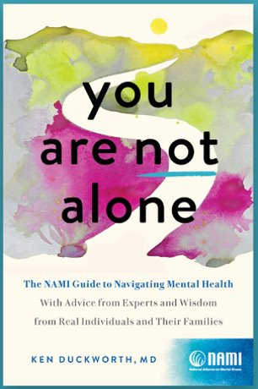
Creating a Caring Culture
Leadership Visibility
Training for Managers & Employees
ERGs: Courageous Conversations
Making Mental Health visible
Tackling burnout, policies & practices
Finding new ways to check in
  Walks, lunches
Book Club with You Are Not Alone
What else?

Slide 16
Language We Use
CONSIDER:
Wild
The weather is unpredictable
My daughter has schizophrenia
Lives with, has or experiences
Died by suicide; took their own life; attempted suicide
What else?
INSTEAD OF:
Crazy
The weather is so bipolar
My daughter is schizophrenic
Suffers from, afflicted with or mentally ill
Committed suicide; successful suicide; failed suicide
What else?
https://nami.org/NAMI/media/NAMI-Media/Infographics/NAMI-Language-Matters.pdf

Slide 17
How NAMI Works with Partners

Slide 18

Strategies for Strengthening Prevention
MH Education, Resources & More
NAMI StigmaFree Partnership
Intranet Based Resources
Lunch & Learns
Offer Tips & Tricks
Webinars with Experts
What have you done?
Visit NAMI.org for high impact resources.

Slide 19

Improving Access to Care & Support
EAP: How's the data?
Digital Health Solutions
Health Benefits: How's the network?
NAMI in the Community
Navigators
988 & Crisis Services
What's missing?

Slide 20
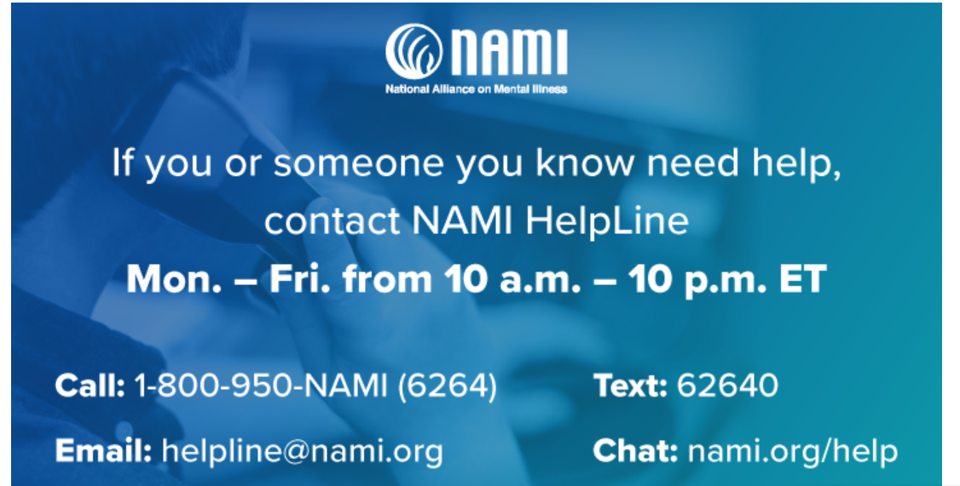
For a Mental Health Crisis: Call 988

Slide 21
Thank you!
Questions, Comments, Discussion
Kate Kennedy-Lynch
Director, External Relations, NAMI
kkennedy-lynch@nami.org
visit: nami.org

