Slide 1
Mental Health Awareness

Slide 2
Email to PetSmart-All
Senior Leaders set the stage sharing their own personal stories
Email to the entire PetSmart team kicking off Mental Health Awareness Month
2023 PetSmart
Notes:
We had a Coffee Chat session in April hosted by an Officer of the company. In it, he shared his personal journey with anxiety, OCD, and an eating disorder. These stories from our senior-most leaders set the stage that it’s both ok to talk about mental health, while also reinforcing that mental health is something that affects every associate at every level.

Slide 3
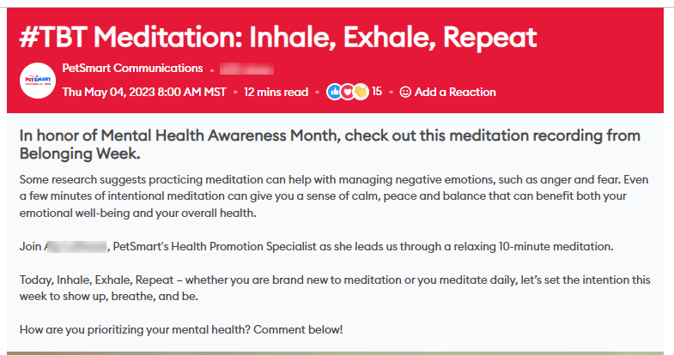
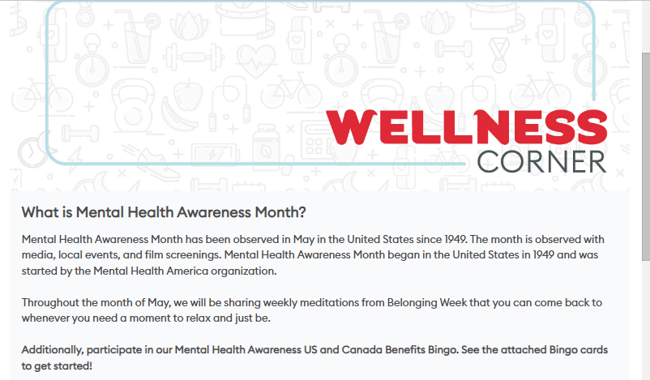
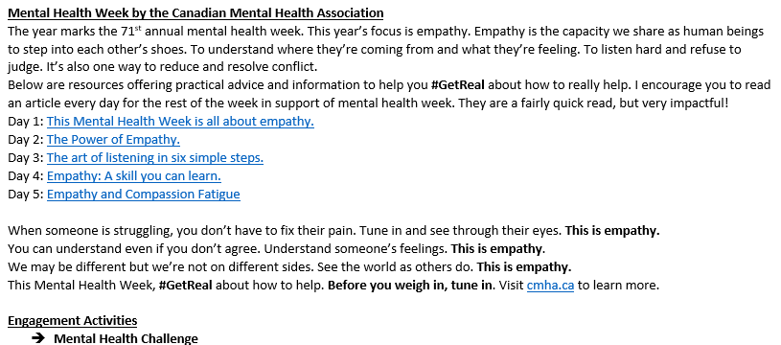
Intentional Communication All Year Long
2023 PetSmart

Slide 4
Toolkit of Resources
Resources for associates and leaders to leverage throughout the month
Includes posters, Teams Backgrounds, Conversation Prompts and more
2023 PetSmart

Slide 5
Example Conversation Prompts
2023 PetSmart

Slide 6
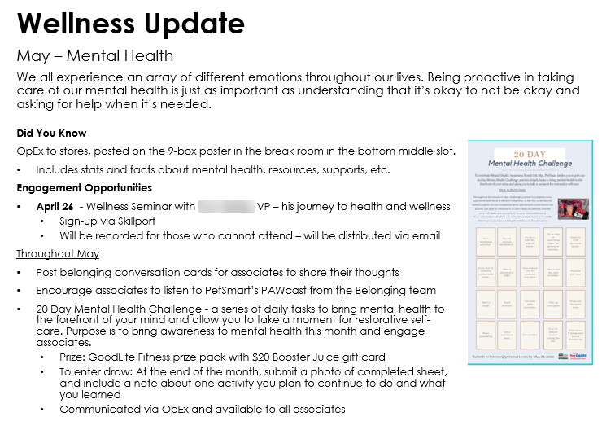
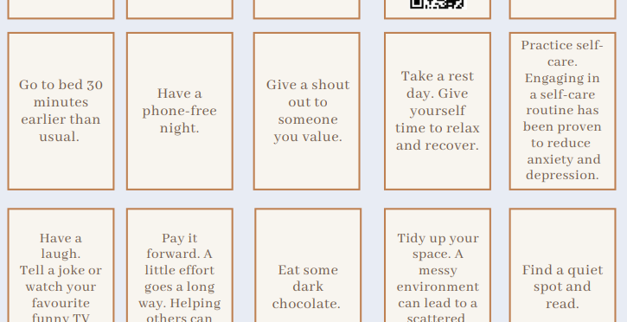
20 Day Mental Health Challenge
Download a copy of the challenge and make it your own!
https://benefits.petsmart.com/wp-content/uploads/20-Day-Mental-Health-Challenge.pdf
2023 PetSmart

Slide 7
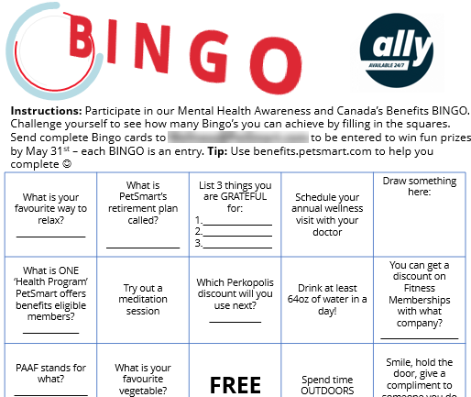
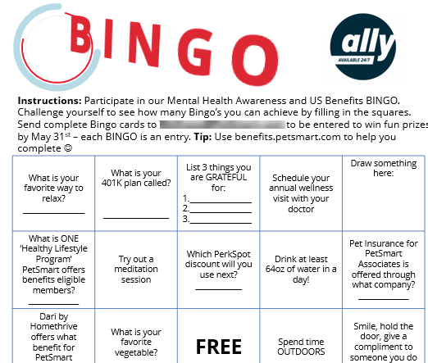
Mental Health Awareness Bingo
Canada Bingo Card
US Bingo Card
2023 PetSmart

Slide 8
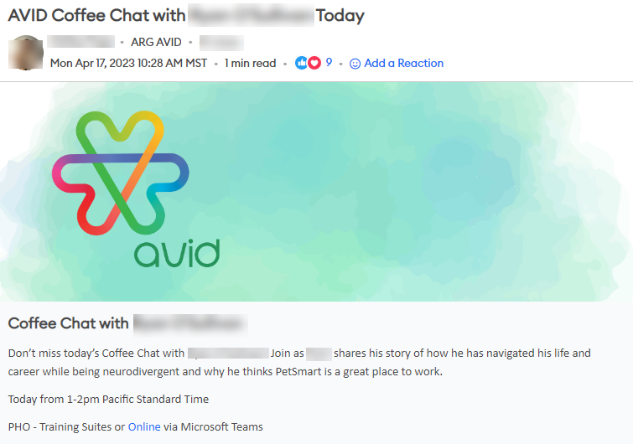
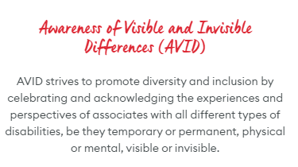
Associate Resource Group Engagement
2023 PetSmart
Notes:
There are multiple other things not called out in this deck, including the fact that we have a dedicated health promotions specialist on site who facilitates weekly meditation and mindfulness sessions and walking groups. And how our Leave policy prioritizes mental health.
As you can see, it’s more than just an email or Teams Background that ensures your people feel seen and psychologically safe. We’ve created an intentional program that weaves in events, activities, communications, and systems and structures to support our work as it relates to acknowledging, talking about, and supporting Mental Health.

